Slide 1
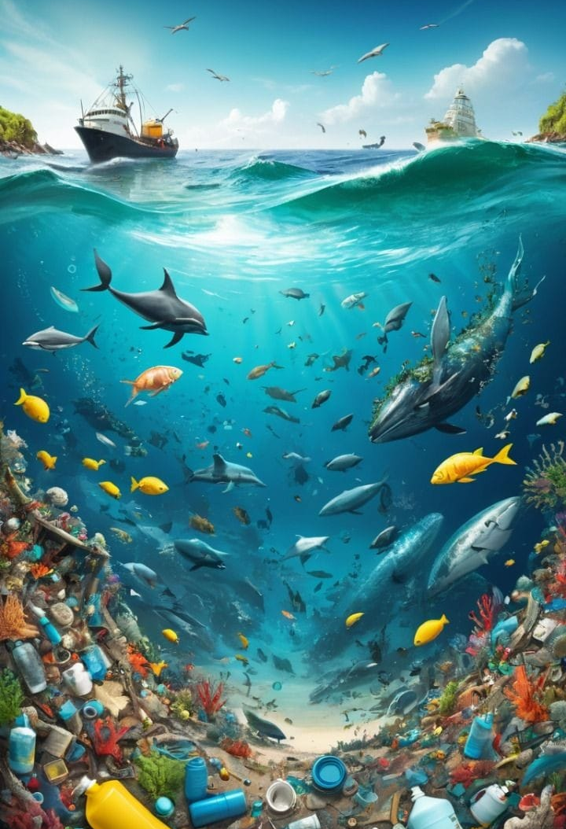
WATER POLLUTION DATASET

Slide 2
Main Topics
Introduction
Table Overview
Column name Descriptions
Showing Objective and Output

Slide 3
WATER POLLUTION:A QUICK REVIEW
Water pollution is the contamination of water bodies due to harmful substances being released into them
It has a huge impact on our environment such as destruction of
aquatic life oxygen depletion ,waterborne diseases
Over 2 billion people lack access to safe drinking water
Millions of death by drinking contaminated water

Slide 4
Table Overview:
The table is designed to analyze the impact of water pollution on public health,
Access to clean water and socio-economic indicators across
different countries regions and years.
It shows about the severity of contamination.
Monitoring water treatment and sanitation efforts
About the number of different waterborne diseases

Slide 5
Table view

Slide 6
Data Analysis and Objectives
1 Name of country with highest contamination level than all countries in a specific region
2 Retrieved unique countries that recorded cholera cases
3 Highest infant mortality rate than all countries in respective central region
4 Top 5 regions that has three waterborne diseases like typhoid , cholera and diarrhea
5 Country names where nitrate level is below average but above average lead conc.
6 Names of country has high rainfall but very less availability of clean water
7 Names of countries with all diseases below average
8 Top 5 countries that has comparatively low turbidity

Slide 7
Objectives
Count the number of rows with countries having all three diseases above average
Top 5 regions have average amount of clean water across the years
Country names have GDP<5000 and poor above average clean water access
Name of countries having clean water availability less than any other countries
Countries where nitrate level greater than some countries
Countries where average fresh water greater than 40%
Regions where average diarrhea cases lower than 300(people)
Name of countries that have recorded diarrhea or typhoid cases
Countries that are not recorded in certain regions
Countries where ph value of water never exceeded above 8.5
Countries that has no water treatment method and average dissolved oxygen
Regions where ph values is outside the safe range (<7)

Slide 8
Objective
21 All the details of countries which having highest rainfall
22 Countries which have reported pH level in neutral range(6.5 - 7)
23 Countries with no access to clean water over some years
24 Top 5 countries that reported acidic water samples(below 7)
25 Top 5 Countries with lowest average healthcare index
26 Countries with water source name contains ‘river’
27 Countries with no record of using "Filtration" in treatment
28 Countries with name contains ‘gla’ and have typhoid cases
29 Countries with water source name not containing ‘lake’
30 Countries where lower ph level than all other records
31 Countries where lower nitrate level than all other records
32 Countries where lower dissolved oxygen level than all other records

Slide 9
Objectives
33 Countries that have ever had more than the average typhoid cases
34 Total rainfall in the year with highest lead concentration
35 Countries with clean water, and average clean water above 50%
36 Water sources with lead concentration data, having average lead above 2.0
37 Countries using filtration, with total diarrhea cases above 5000
38 Countries with average pH level not equal to 7
39 Water treatment methods used in countries starting with 'M', with more than 3 records
40 Reduce lead concentration by 10% for countries with high healthcare index

Slide 10
Conclusions
Worse impact of water pollution
Dangerous effect of dumping chemical waste in water
Good water treatment method is good for health and biodiversity and water treatment methods are essential
Founded top countries on its preferences of water pollution
pH and Dissolved Oxygen Are Key Health Indicators
Industrial Pollutants Drive Heavy Metal Contamination
Clean Water Access Reduces Disease Burden

Slide 11
Insights
Rain water reservoirs can be constructed especially where rain fall
is low
Filtration methods should be mandatory for those regions/countries
who doesn’t use any and methods should be eco friendly
Conduct awareness classes about the adverse effect of water pollution
Reduce the chemical uses and find effective ways to dispose these wastes
Proper waste management measures can be taken rather than dumping into water
Minimize the use of plastics and avoid its dumping to water and save aquatic life
Report and take immediate actions against the illegal waste disposals

Slide 12
Thank you
By
ALFIN THOMAS

